Slide 1


The State of Tcl/Tk
EuroTcl 2009

Slide 2
Current Status
Production Release: 8.5.7
  Recommended for deployment
Development Version: 8.6b1
  Many new features, some ultra-exciting!
Bleeding Edge: 8.6b1.1
  Current CVS checkout
    A few extra features that missed 8.6b1
    More bug fixes
  Close to 8.6b2

Slide 3
Timeline
Production: 8.5
  8.5.0 → 20 December 2007
  8.5.7 → 16 April 2009
Development: 8.6
  8.6b1 → 19 December 2008
    Tried to keep shorter cycle than for 8.5
  8.6b2 “soon”
  8.6.0 → Tcl’2009 in September

Slide 4
Major New Features of Tcl 8.6
Non-Recursive Engine
  Coroutines, Tailcalls, Less stack hammering, …
TclOO
  Basic high-performance object system
[incr Tcl] Next Generation (itcl-ng/itcl4)
  New version based on top of TclOO framework
TDBC
  Standard database interface
    On top of TclOO framework
  Drivers not included
Thread
  To be included by default

Slide 5
More New Tcl Script Features
Scripted channel transforms
Zlib compression
Execution cancellation
Built-in base64 encoding
Standalone pipes
Better string prefix handling
Method to get $env(PATH) separator
Extend “string trim” whitespace def.
More commands “do nothing” gracefully
Improved list searching
Striding list sorts
List extension with “lset”
“File tempfile” to make temporaries
Better exception handling with “try”
Half-close of bidirectional channels
Multiple patterns in “dict filter”
“Format”/“scan” base-2 support

Slide 6
New Tcl C API Features
NRE API
  Allow user commands to be restartable
TclOO API
  Create and manage classes, instances and methods
Make Tcl_Interp opaque
  Eliminate interp->result
  API for interp->errorLine
Detection of active interpreters
Option parser (from Tk)
Portable Tcl_StatBuf access
Expose TclTransferResult()
Expose TclBackgroundException()
Access to startup scripts

Slide 7
Showing Off: Classes
oo::class create integrator {
variable exp sum delay tBase t0 k0 aid
constructor {{interval 10}} {
set delay $interval
set tBase [clock microseconds]
set t0 0
set exp { 0.0 }
set k0 0.0
set sum 0.0
set aid [after $delay \
[namespace code {my Step}]]
}
destructor {
after cancel $aid
}
method input expression {
set exp $expression
}
method output {} {return $sum}
method Eval t {expr $exp}
method Step {} {
set aid [after $delay \
[namespace code {my Step}]]
set t [expr {
([clock microseconds]-$tBase)/1e6
}]
set k [my Eval $t]
set sum [expr {
$sum + ($k+$k0) * ($t-$t0) / 2.
}]
set t0 $t; set k0 $k
}
}
This is an example
from Rosetta Code

Slide 8
Showing off: Coroutines
proc task {script} {
coroutine task_ apply [list {} ”
$script
set ::done ok
"]
vwait done
}
proc pause {seconds} {
yield [after [expr {
int($seconds * 1000)
}] [info coroutine]]
}
set pi 3.14159265
task {
integrator create int0
int0 input {
sin(2*$::pi * 0.5 * $t1)
}
pause 2
int0 input { 0.0 }
pause 0.5
puts [format %.15f [int0 output]]
}
Prints: -0.000000168952702

Slide 9
Showing off: TDBC
package require tdbc::sqlite3
tdbc::sqlite3::connection create db \
"phonebook.sqlite3"
set statement [db prepare {
select phone_num from directory
where first_name = :firstname
and last_name = :lastname
}]
db transaction {
set firstname "Fred"
set lastname "Flintstone"
$statement foreach row {
puts [dict get $row phone_num]
}
}
$statement close
db close

Slide 10
New Features of Tk 8.6
Windows Vista theme for Ttk
Canvas features
  Absolute canvas item positioning
  Canvas item vertex editing
  Angled text items
Unfocussed text widget cursor control
New “tk busy” command
Standard font selection dialog
PNG image support
Updated mouse-wheel behavior

Slide 11
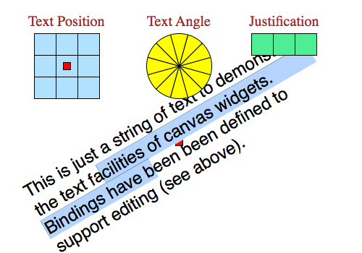
Showing off Angled Text…
.canv create text 300 300 -text "sample” -angle 30

Slide 12
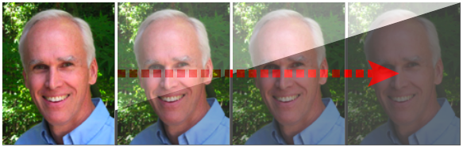
Showing off PNG Images
image create photo o3 -file ouster.png -format "png -alpha 0.5"

Slide 13
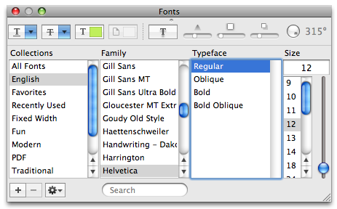
Showing off the (OS X) Font DiaLog
tk fontdialog show

Slide 14
Where Next?
8.6 Plans…
  Fix bugs
  Improve performance
  Tk on OSX to use Cocoa
  Make prettier
  Production release in Autumn
Tcl future directions
  Coupling arrays to non-classical back-ends
  HTTP/1.1 (GSoC!)
  Regexp improvements (GSoC!)
  Scripted virtual file-system
Future Tk directions
  Image handling (GSoC!)
  Megawidgets
  Printing? (GSoC!)

