Slide 1

Running your own Wikit with Wubwikit
Wikitcl features
WubWikit as CMS
Jos.decoster@gmail.com

Slide 2
Overview
Wiki features
Running your own WubWikit
WubWikit as CMS

Slide 3
Wiki features
New Wikitcl markup
Images
New actions
Special pages
Alternative markup

Slide 4
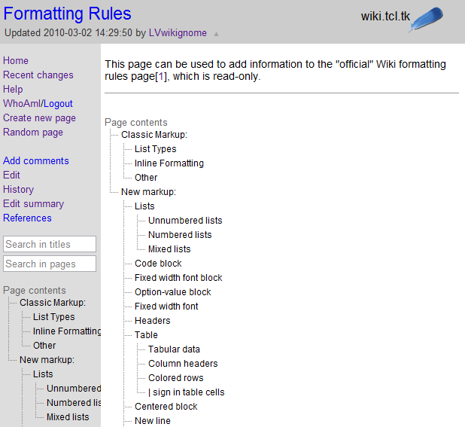
Wiki features: new Wikitcl markup
Include table of contents in page
Line containing <<TOC>>

Slide 5
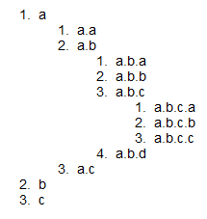
Wiki features: new Wikitcl markup
Nested lists: numbered
3 spaces followed by 1 or more digits, a dot and a space
Number of digits is nesting level
1. a
11. a.a
11. a.b
111. a.b.a
111. a.b.b
111. a.b.c
1111. a.b.c.a
1111. a.b.c.b
1111. a.b.c.c
111. a.b.d
11. a.c
1. b
1. c

Slide 6
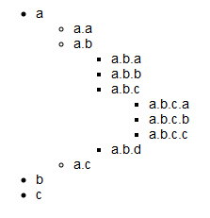
Wiki features: new Wikitcl markup
Nested lists: unnumbered
3 space followed by one or more * followed by a space
Number of * is nesting level
* a
** a.a
** a.b
*** a.b.a
*** a.b.b
*** a.b.c
**** a.b.c.a
**** a.b.c.b
**** a.b.c.c
*** a.b.d
** a.c
* b
* c

Slide 7
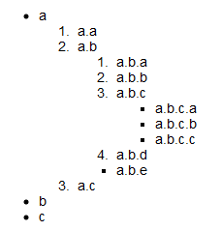
Wiki features: new Wikitcl markup
Nested lists: mixed numbered/unnumbered
* a
11. a.a
11. a.b
111. a.b.a
111. a.b.b
111. a.b.c
**** a.b.c.a
**** a.b.c.b
**** a.b.c.c
111. a.b.d
*** a.b.e
11. a.c
* b
* c

Slide 8

Wiki features: new Wikitcl markup
Code block
Block starting and ending with a line containing 6 equal signs
Rendered in fixed width font
Line markup not processed
Replaces lines starting with a space
======
A '''code'''
''block''
[Tcl]
======

Slide 9

Wiki features: new Wikitcl markup
Fixed width font block
Block starting and ending with a line containing 3 equal signs
Rendered in fixed width font
Line markup still processed
===
A '''fixed width'''
font ''block''
[Tcl]
===

Slide 10
Wiki features: new Wikitcl markup
Fixed width font line markup
Piece of text in fixed width font
Delimited by back quotes
When putting one or more words in a line between back-quotes, those words will be printed in a `fixed width font`.

Slide 11

Wiki features: new Wikitcl markup
Option-value block
Block starting and ending with line containing 3 plus signs
Each line in an option-value block starts with an option, 2 or more spaces and then the value
The option is shown in a fixed width font
+++
a_command ''arg1'' ''arg2'' a command and arguments
b_command ''arg1'' ''arg2'' b command and arguments
+++

Slide 12
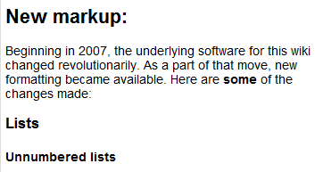
Wiki features: new Wikitcl markup
Headers
Lines starting and ending with 2, 3 or 4 * signs
Shown in left hand menu and with <<TOC>>
**New markup:**
Beginning in 2007, the underlying software for this wiki changed revolutionarily. As a part of that move, new formatting became available. Here are '''some''' of the changes made:
***Lists***
****Unnumbered lists****

Slide 13
Wiki features: new Wikitcl markup
Tables
Plain table rows are lines starting and ending with a | sign
Colored rows start with &| and end with |&
Header rows start with %| and end with |%
Cells are separated with a |
Use <<pipe>> to show a | sign in a cell
Also use <<pipe>> when a non table line must start with a | sign

Slide 14

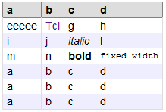
Wiki features: new Wikitcl markup
Tables
|a|b|c|d|
|eeeee|[Tcl]|g|h|
|i|j|''italic''|l|
|m|n|'''bold'''|`fixed width`|
%|a|b|c|d|%
&|eeeee|[Tcl]|g|h|&
&|i|j|''italic''|l|&
&|m|n|'''bold'''|`fixed width`|&
&|a|b|c|d|&
&|a|b|c|d|&
&|a|b|c|d|&

Slide 15
Wiki features: new Wikitcl markup
Centered block
Block starting and ending with lines containing 6 ! signs

Slide 16
Wiki features: new Wikitcl markup
Renaming links
Add %|%name%|% to end of internal or external link to show specified name in stead of link target
Click [Formatting Rules%|%here%|%] for more info on formatting rules or http://wiki.tcl.tk%|%here%|% to go to the home page.

Slide 17
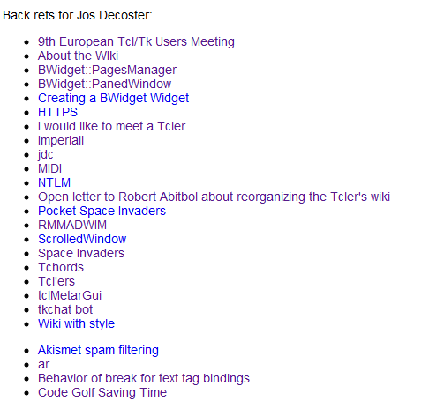
Wiki features: new Wikitcl markup
Back references
Line containing <<backrefs>> will include back-references to current page
Line containing <<backrefs>> followed by a page name will include back references to specified page
Rendered as unnumbered list
Back refs for Jos Decoster:
<<backrefs>>Jos Decoster
<<backrefs>>jdc

Slide 18

Wiki features: new Wikitcl markup
Categories shortcut
Line starting with <<categories>>
Followed by the names of the category pages separated with a | sign, where the word Category is optional
Equivalent to specifying a horizontal ruler and a centered table header with different categories in the cells
<<categories>> Discussion | Development

Slide 19
Wiki features: new Wikitcl markup
Including doctool markup
Surround a piece of text in doctool format by lines containing <<doctool>>
This is a wrapper for the Windows [Midi] stream API.
**News**
* [jdc] 10-jul-2009. Source code and downloads now available at http://code.google.com/p/tclmidi
* [jdc] 20-mar-2008. Initial public release.
**Man page**
<<doctool>>
[comment {-*- tcl -*- doctools manpage}]
[manpage_begin midistreamdll n 0.4]
[copyright {2007-2008 Jos Decoster <jos.decoster@gmail.com>}]
[moddesc {Wrapper for the Win32 Midi stream API}]
[titledesc {Wrapper for the Win32 Midi stream API}]
[require Tcl 8.5]
[description]
[para]
This page describes the Tcl [package midistreamdll] package, a wrapper for the
Win32 Midi stream API. Commands to query the available Midi devices, open a Midi
stream device and send Midi data to it are discussed here.

Slide 20
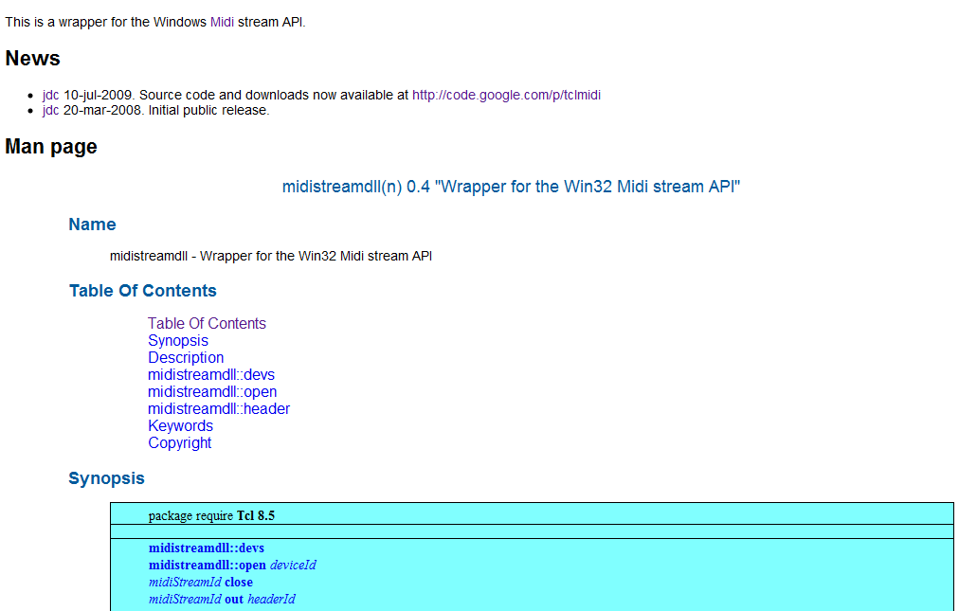
Wiki features: new Wikitcl markup
Including doctool markup

Slide 21
Wiki features: new Wikitcl markup
Including nroff markup
Surround a piece of text in (tcl) nroff format by lines containing <<tclnroff>>
Combining '''Tcl-nroff''' and '''Wikit''' markup in adding the `dict` man page to the Wiki:
<<tclnroff>>
'\"
'\" Copyright (c) 2003 Donal K. Fellows
'\"
'\" See the file "license.terms" for information on usage and redistribution
'\" of this file, and for a DISCLAIMER OF ALL WARRANTIES.
'\"
'\" RCS: @(#) $Id: dict.n,v 1.21 2009/01/07 13:50:03 dkf Exp $
'\"
.so man.macros
.TH dict n 8.5 Tcl "Tcl Built-In Commands"
.BS
'\" Note: do not modify the .SH NAME line immediately below!
.SH NAME
dict \- Manipulate dictionaries
.SH SYNOPSIS
\fBdict \fIoption arg \fR?\fIarg ...\fR?
.BE
.SH DESCRIPTION
.PP
Performs one of several operations on dictionary values or variables
containing dictionary values (see the \fBDICTIONARY VALUES\fR section
below for a description), depending on \fIoption\fR. The legal
\fIoption\fRs (which may be abbreviated) are:
.TP
\fBdict append \fIdictionaryVariable key \fR?\fIstring ...\fR?
.

Slide 22
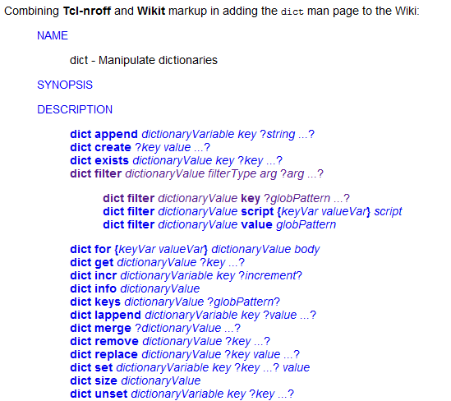
Wiki features: new Wikitcl markup
Including nroff markup

Slide 23
Wiki features: new Wikitcl markup
Inline HTML
Block starting and ending with line containing <<inlinehtml>>
Disabled by default

Slide 24
Wiki features: new Wikitcl markup
Inline HTML
<<inlinehtml>>
<embed type="application/x-shockwave-flash" src="http://picasaweb.google.com/s/c/bin/slideshow.swf" width="500" height="500" flashvars="host=picasaweb.google.com&captions=1&noautoplay=1&hl=en_US&feat=flashalbum&RGB=0x000000&feed=http%3A%2F%2Fpicasaweb.google.com%2Fdata%2Ffeed%2Fapi%2Fuser%2F103776411063816501010%2Falbumid%2F5450441999739647681%3Falt%3Drss%26kind%3Dphoto%26hl%3Den_US" pluginspage="http://www.macromedia.com/go/getflashplayer"></embed>
<<inlinehtml>>

Slide 25

Wiki features: new Wikitcl markup
Inline HTML

Slide 26

Wiki features: new Wikitcl markup
Newline
Use <<br>> to insert a line break
Can also be used in table cells
Always wanted a line break between this<<br>>and this word!

Slide 27

Wiki features: new Wikitcl markup
Description
Line containing 3 spaces, item text, colon, 2 or more spaces, description
item ''needing'' '''description''': the '''description''' the item ''needed''

Slide 28

Wiki features: images
Wiki pages can be text or images
Chosen on first edit and can not be changed
Images must be uploaded, text can be entered or uploaded

Slide 29

Wiki features: images
To include image, use internal link markup with [name]
Specify width and height following %|%
[WOMM Certification%|% width=200 height=200]

Slide 30
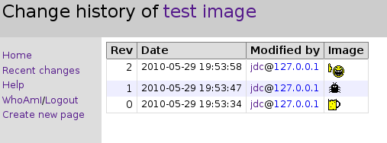
Wiki features: images
Click on included image to go to image page
Back references
History

Slide 31
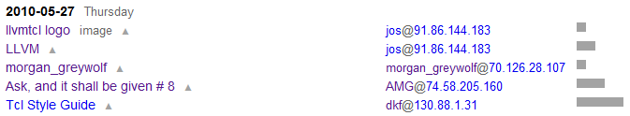
Wiki features: images
Recent changes

Slide 32
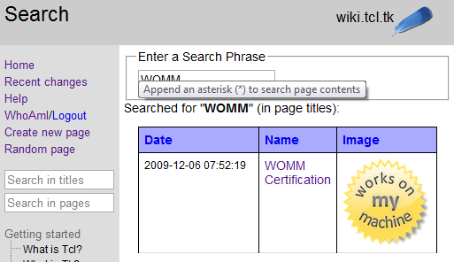
Wiki features: images
Title search

Slide 33
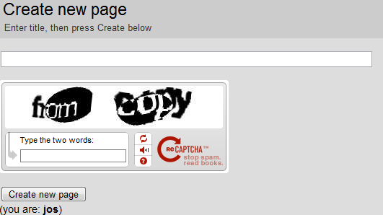
Wiki features: new actions
New page

Slide 34
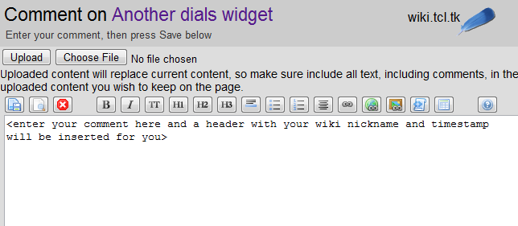

Wiki features: new actions
Comments

Slide 35
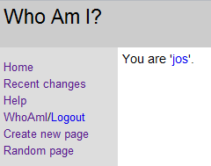
Wiki features: new actions
Who am I / Logout

Slide 36
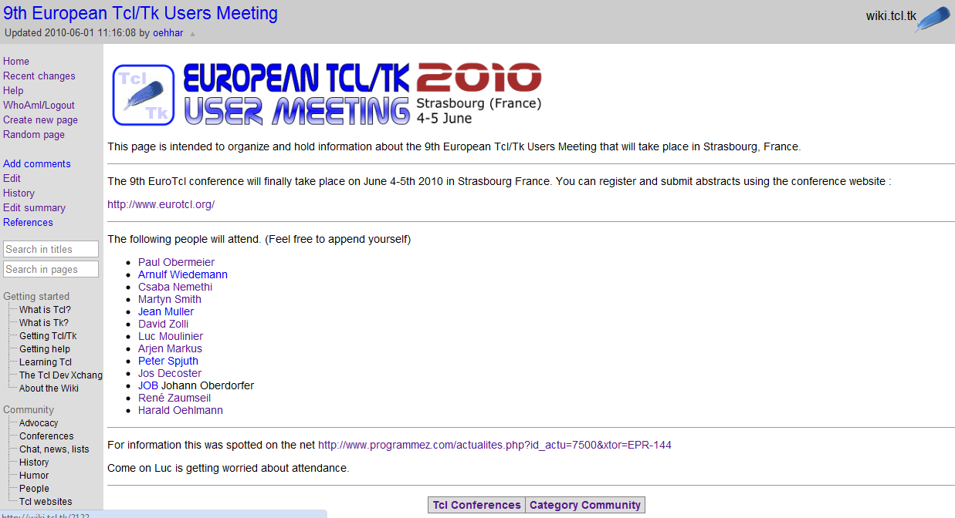
Wiki features: new actions
Random page

Slide 37
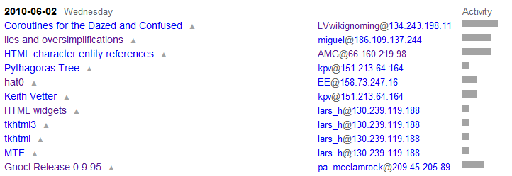
Wiki features: new history actions
Edit summary
Accessed from menu or from activity bar in recent changes
List of line differences for recent edits

Slide 38
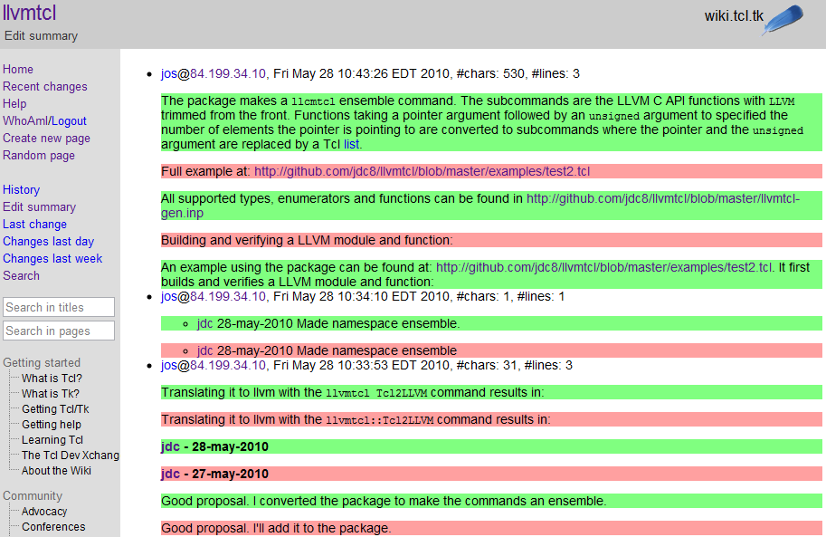
Wiki features: new history actions
Edit summary

Slide 39
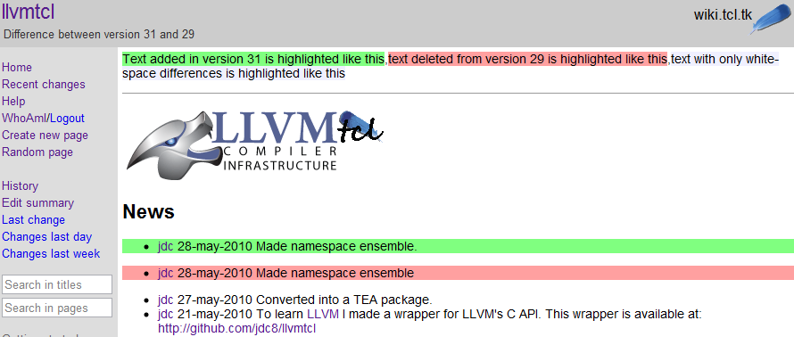
Wiki features: new history actions
Line diffs
Show rendered result of line differences between versions of a page

Slide 40
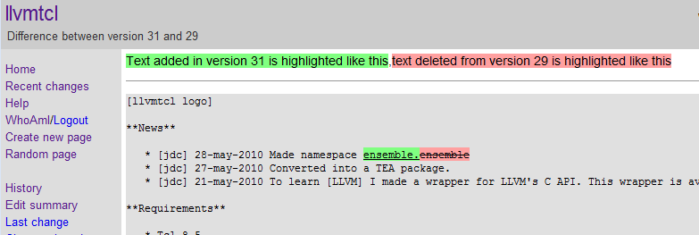
Wiki features: new history actions
Word diffs
Show markup (unrendered) word differences

Slide 41
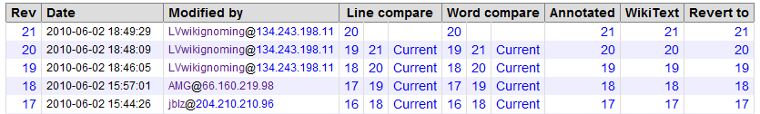
Wiki features: new history actions
Restore page
Click on version to revert to in history table
Answer captcha
Brings you to editor window containing the previous version, save to actually revert

Slide 42
Wiki features: special pages
ADMIN:TOC
Specify left hand menu
Line starting without space is new item
Line starting with spaces is sub-item
  Name in menu
  Name of page to link to in [ ]
  Name of mind-map <href> (Optional, Tclers wiki specific)

Slide 43
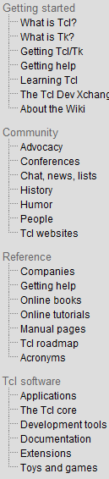
Wiki features: special pages
ADMIN:TOC
Getting started
What is Tcl? [What is Tcl] 5-1
What is Tk? [What is Tk] 5-2
Getting Tcl/Tk [Getting Tcl/Tk] 5-3
Getting help [Getting help] 5-4
Learning Tcl [Learning Tcl] 5-5
The Tcl Dev Xchange [The Tcl Dev Xchange] 5-6
About the Wiki [About the Wiki] 5-7
Community
Advocacy [Tcl Advocacy] 1-1
Conferences [Tcl Conferences] 1-2
Chat, news, lists [Chat, news, lists] 1-3
History [History of Tcl and Tk] 1-4
Humor [Humor as seen by Wikit contributors] 1-5
People [People & Community] 1-6
Tcl websites [Tcl Websites] 1-7
Reference
Companies [Companies that Use Tcl] 4-1
Getting help [Getting help] 4-2
Online books [Online books] 4-3
Online tutorials [Online tutorials] 4-4
Manual pages [The manual pages] 4-5
Tcl roadmap [Tcl Roadmap] 4-6
Acronyms [Acronym collection] 4-7
Tcl software
Applications [Applications] 3-1
The Tcl core [The Tcl core] 3-2
Development tools [Development tools] 3-3
Documentation [Documentation] 3-4
Extensions [Extensions for Tcl and Tk] 3-5
Toys and games [Toys and games] 3-6

Slide 44
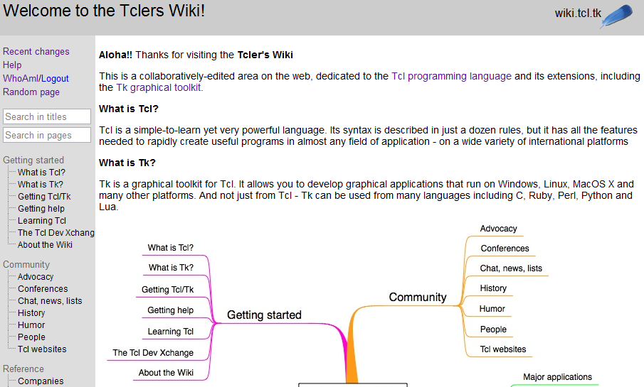
Wiki features: special pages
ADMIN:Welcome
Page containing HTML used on entry page

Slide 45
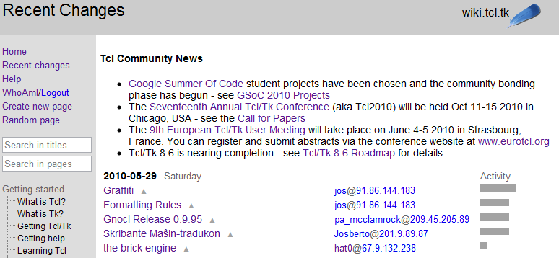
Wiki features: special pages
ADMIN:MOTD
Page containing HTML used as message of the day on recent changes page

Slide 46
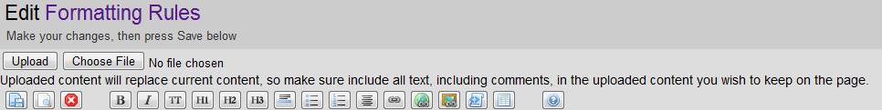
Wiki features: editor toolbar

Slide 47
Wiki features: alternative markup
Wubwikit support 3 markup languages:
  Wikitcl markup (base on original markup of JCW)
  STX (Colin)
  Creole (javascript, rendered in client)
Less special markup and actions for STX and creole:
  No lines diffs
  No annotated history
  No fixed width block (unformatted block is supported)

Slide 48
Running your own WubWikit

Slide 49
Running your own WubWikit
One download from http://code.google.com/p/wubwikit/
Containing:
Wub
Wikitcl
Tdbc for sqlite3
Required parts from tcllib and other required packages
Requirements:
Tcl 8.6, preferably CVS HEAD, with tdbc
Tcl package for Sqlite3

Slide 50
Running your own WubWikit
Installing:
Unzip the archive, starkit when 8.6 is out
Running:
Run main.tcl from the .vfs directory
Help:
wiki database for offline use on Tclers wiki
http://wiki.tcl.tk/20412
Run main.tcl from .vfs directory with the help option

Slide 51
Running your own WubWikit
Database:
Download Tclers Wiki database from http://sourceforge.net/projects/tclerswikidata/files/
Create a new one:
tclsh main.tcl mkdb mywiki.tkd title “My Wiki”
  Creates database with the following pages:
  0 : Start page
  1 : ADMIN:Welcome
  2 : ADMIN:TOC
  3 : ADMIN:MOTD
  4 : Help

Slide 52
Running your own WubWikit
Start your wiki:
tclsh main.tcl wikidb mywiki.tkd
Runs webserver on port 8080
Telnet command port on port 8082
When Tk is available, you get a dialog to open a browser and to stop the webserver
Contents of page ADMIN:Welcome is shown for /

Slide 53
Running your own WubWikit
More command line arguments:
port <port number> (8080)
cmdport <port number> (8082)
logfile <file> (/tmp/wikit.log)

Slide 54
Running your own WubWikit
More configuration options:
Create a local.tcl file with following command:
tclsh main.tcl mklocal local.tcl
Edit local.tcl to configure WubWikit
Specify local.tcl when running your wiki:
tclsh main.tcl … local local.tcl

Slide 55
Running your own WubWikit
More configuration options:
Variable | Type | Default
::WikitWub::inline_html | boolean | 0
::WikitWub::readonly | string | “”
::WikitWub::hidereadonly | boolean | 0
::WikitWub::markup_language | Enum: wikit, creole, or stx | wikit
::WikitWub::wiki_title | string | “”
::WikitWub::text_url | url | www.mywiki.net

Slide 56
Running your own WubWikit
More configuration options:
Variable | Type | Default
::WikitWub::welcomezero | boolean | 0
perms | dict | {admin {admin admin}}
::WikitWub::recaptcha_public | string | “”
::WikitWub::recaptcha_private | string | “”
::WikitWub::gsearch | boolean | 0
::google_jsapi_key | string | “”
::WikitWub::empty_template | String | "This is an empty page.\n\nEnter page …”

Slide 57
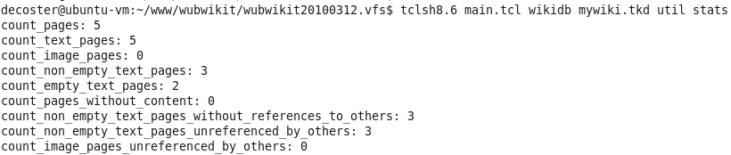
Running your own WubWikit
Utils
Statistics can be obtained with utils part of wubwikit or by using sqlite3 on the database
Check the wiki page or help for a list of provided utilities

Slide 58
Running your own WubWikit
Dumping database contents
util ids to print one line for each page to stdout containing :
  Id
  Indication if empty or not
  Page title
Input for html/markup utils

Slide 59
Running your own WubWikit
Dumping database contents
util html|markup page <id> to print html /image or markup for specified page to file <opath>/<page-id>.html|txt.
util html|markup pages <file> to print html/image or markup for each page specified with its <page-id> in <file> to file <opath>/<page-id>.html|txt.

Slide 60
WubWikit as CMS

Slide 61
WubWikit as CMS
Creating your site:
Use Wiki functionality to edit your site
Use inline HTML where the markup can’t express what you’re after
Prepare you site offline
Deploy with Wub as server or as static site

Slide 62
WubWikit as CMS
Look:
Tcler’s wiki look by default
Some config options to set title and site name
Copy some images (e.g. favicon)
Adjust look by
  Editing the wikit.css files
  Providing you own template (e.g. in local.tcl):
    Page template
    Header

Slide 63
WubWikit as CMS
Using your own template:
Create CSS, images, JS, … for your look and put those in the css, images, JS directories
Create template command for type page to create a <div> with the rendered page
template page {$name} {
[<div> class container [subst [template header]][subst {
[expr {[info exists ::WikitWub::ro]?$::WikitWub::ro:""}]
[<div> id wrapper [<div> id content $C]]
}][subst [template menu]][subst [template footer]]]
}

Slide 64
WubWikit as CMS
Using your own template:
Special variables available in template
Variable name | Description
C | Rendered page contents
Title | Page title
subtitle | Sub title of page
menu | Menu
page_toc | Page menu (**, ***, ****)
WikitWub::TOC | Wiki menu
footer | Page footer

Slide 65
WubWikit as CMS
Using your own template:
Set WikitWub::head variable if
  Other css needs to be included
  Other javascript needs to be included
  Meta tag need to be set

Slide 66
WubWikit as CMS
Using your own template:
Template and header as set here will change how the content pages are displayed.
Other (meta) pages keep the Tclers wiki style (set template spage and header shead for these)

Slide 67
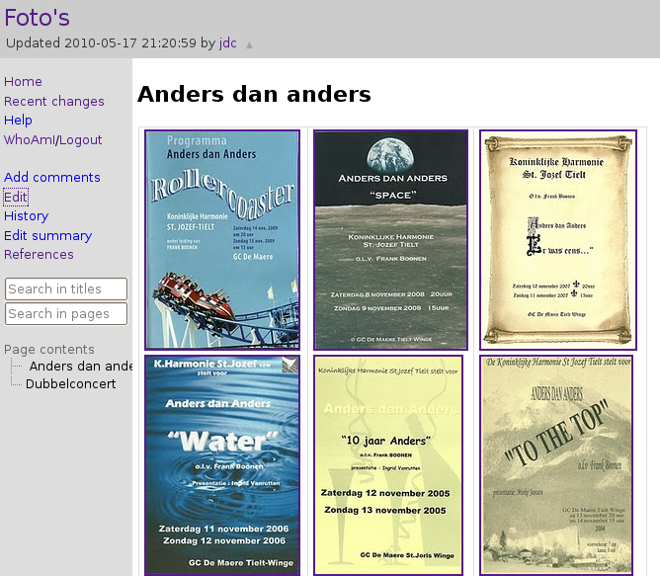
WubWikit as CMS
Example: http://www.harmonie-sint-jozef-tielt.be
Default style

Slide 68
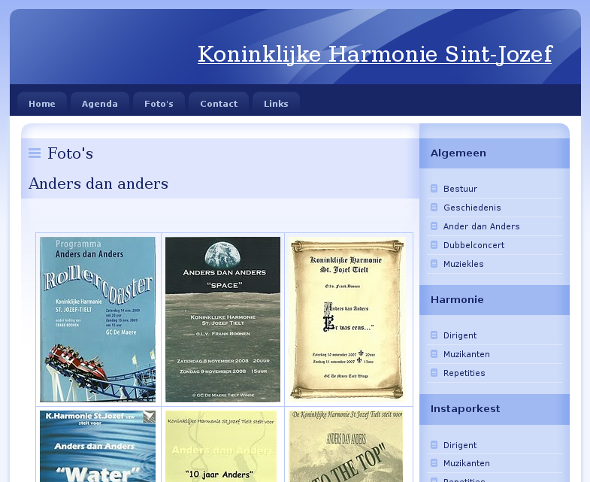
WubWikit as CMS
Example: http://www.harmonie-sint-jozef-tielt.be
Custom style (taken from http://www.nuvio.cz/)

Slide 69
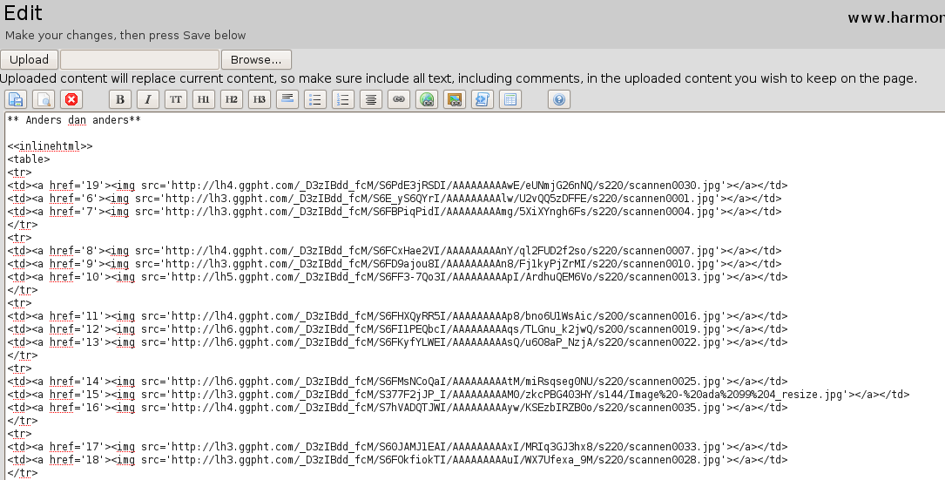
WubWikit as CMS
Example: http://www.harmonie-sint-jozef-tielt.be
Default style for meta pages

Slide 70
WubWikit as CMS
Deployment
With Wub as server: copy local setup to server
As static site:
  Put css, images, javascript on server in directory structure expected by generated html
  Generate list of pages (both text and images) with the ids utility
  Generate html or image for all the pages using html pages util
  Copy generated files to server

Slide 71
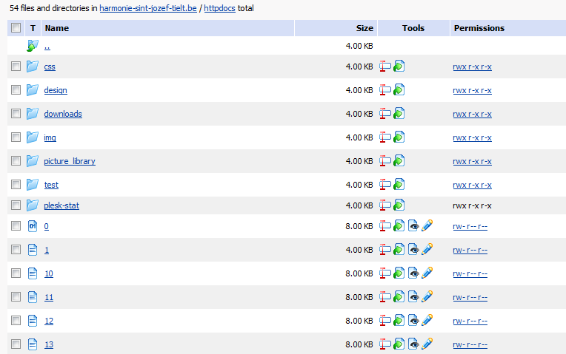
WubWikit as CMS
Deployment as static site
Example: http://www.harmonie-sint-jozef-tielt.be

Slide 72
Conclusions
Wikitcl offers a lot of markup and actions
Data and images in one file
Easy to extend as it is Tcl only and based on the Tcl only webserver Wub
Simple to use when maintaining a read-only website

Slide 73
Questions?

